Slide 1
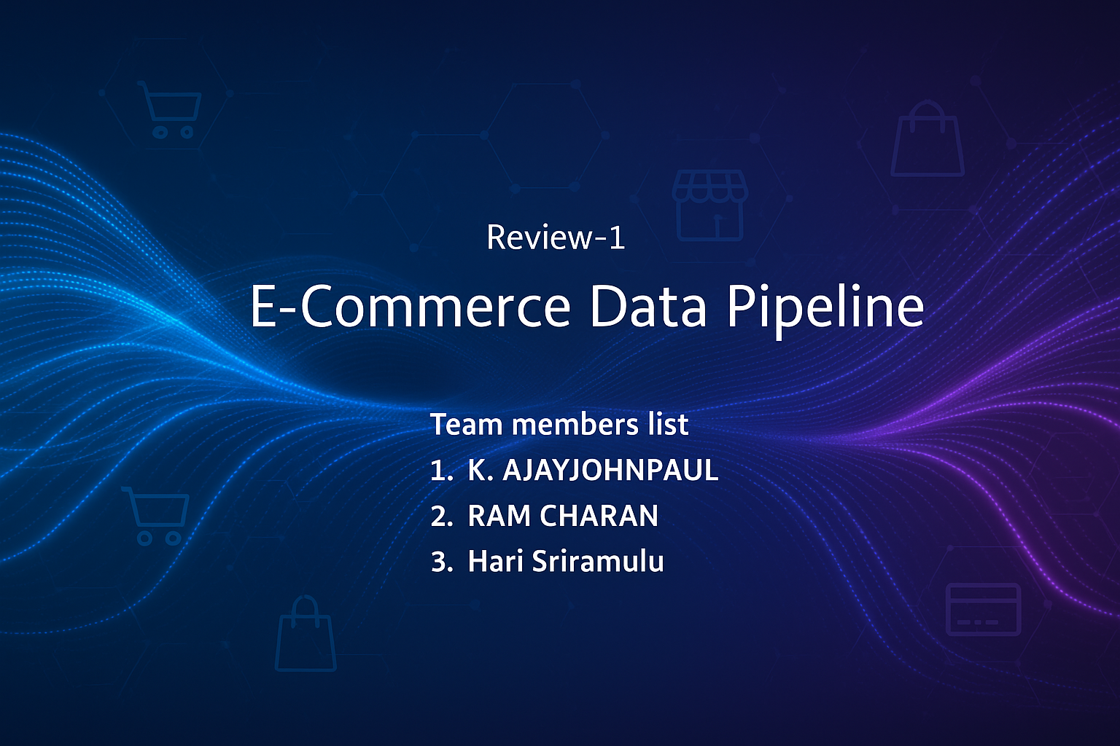

Slide 2
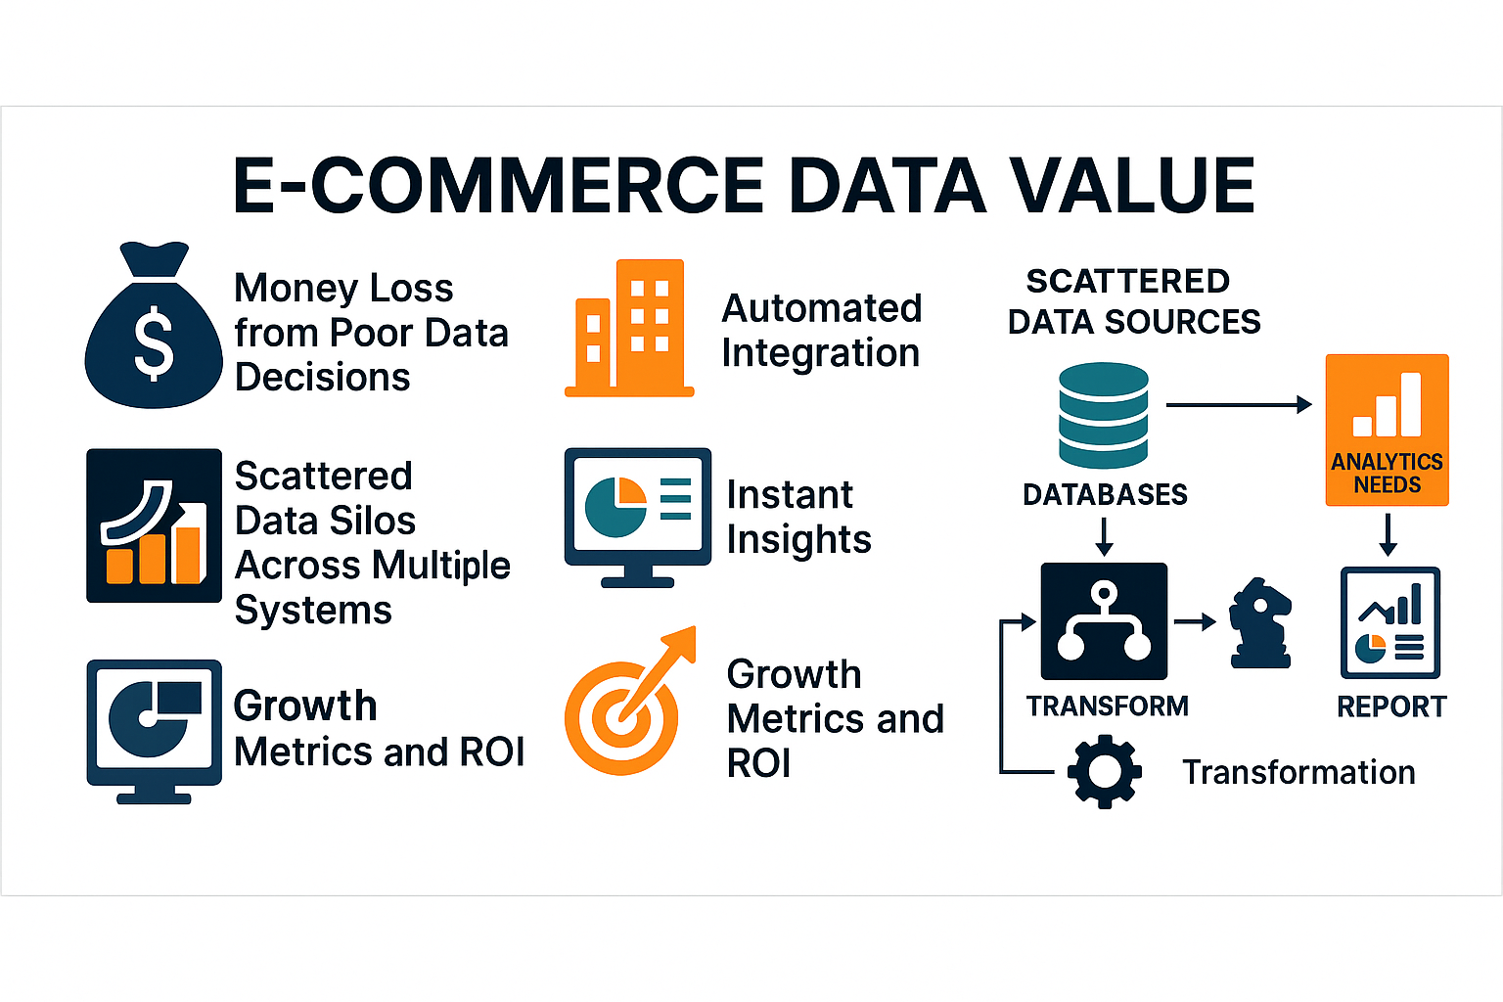
INTRODUCTION FLOWCHAT

Slide 3
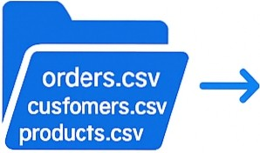



ETL Pipeline
Extracts data
f rom CSV f iles
Transforms data
by Pandas cleaning
Loads into PostgreSQL normalized tables
Visualizes with Streamlit dashboard
•
e
Extract
Transform
Load
Pandas cleaning
normalized tables
Visualize

Slide 4
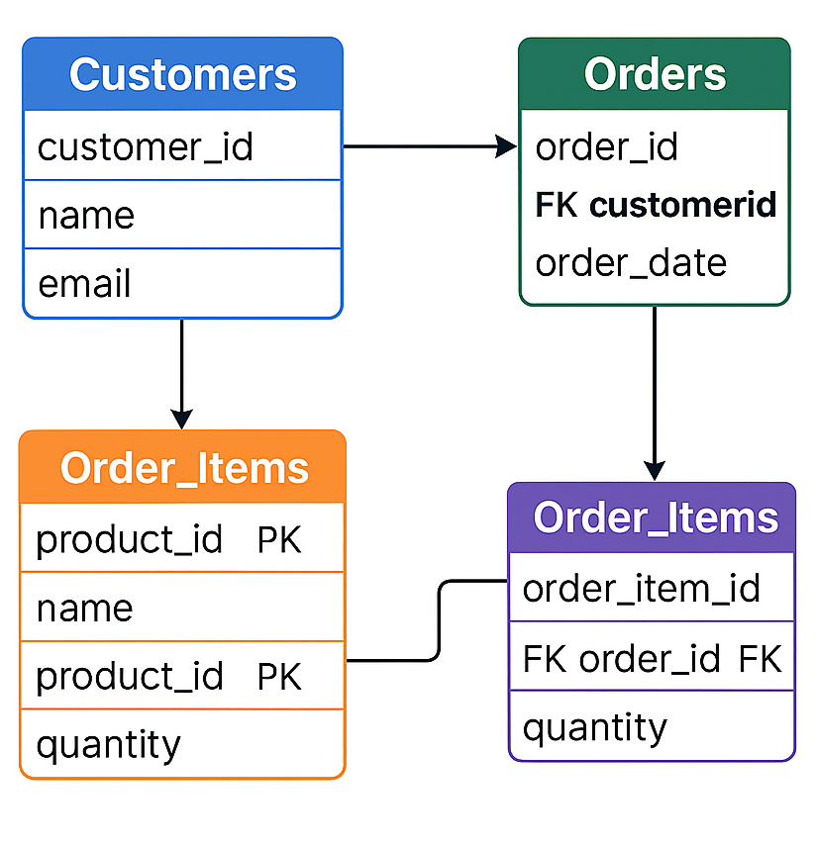
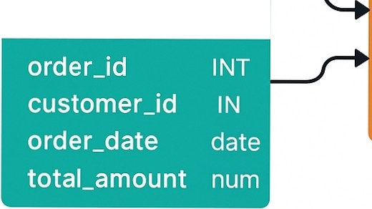



























DATA BASE DESIGN
Customers
customer_id
INT
varc
varc
f irst_name
last_name
Order_ltems
A table for customers, a
table for products, and
Orders
an orders table with associated order items.
Products
product_id
 |  |  |  | PK
product_name
price |  |  | num"

Slide 5
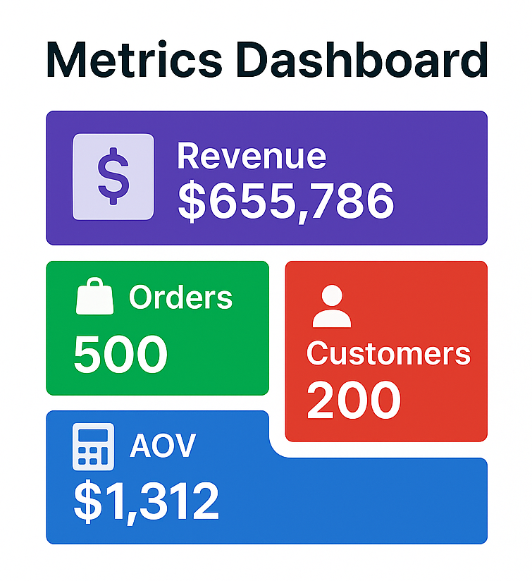
PROJECT RESULTS
Revenue surpassed
$650,000, reflecting strong sales performance.
We received 500 orders, indicating a healthy level of transaction volume.
The AOV was $1,312, suggesting high-value purchases.
..$655,786

Slide 6
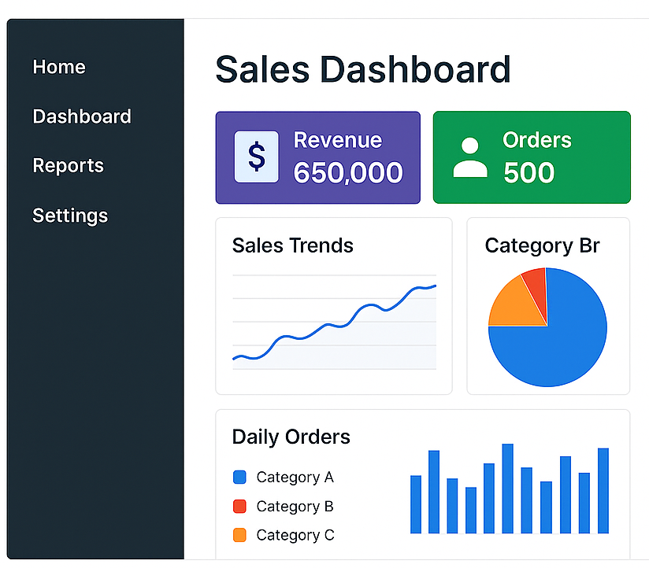
INTERACT IVE DASHBOARD
An interactive web dashboard with charts and graphs, allowing users to view and analyze
data, monitor key metrics, and gain insights

Slide 7
Python ETL Pipeline
PYTHON ETL CODE
Defines a simple class called ETLPipeline
with methods to extract, transform, and load data.
class ETLPipeline:
def extract_data (self): pass
def transform_data (self, data): pass
def load_data (self, data): pass
}
500
records/sec

Slide 8




SYSTEM PERFORMANCE
I I I
I I I
Query Speed
<100 ms <3s
Dashboard Processing
Scalability
500 rec/sec
The system has been optimized for high query speed, efficient dashboard rendering,fast processing rates, and scalability for future growth.

Slide 9
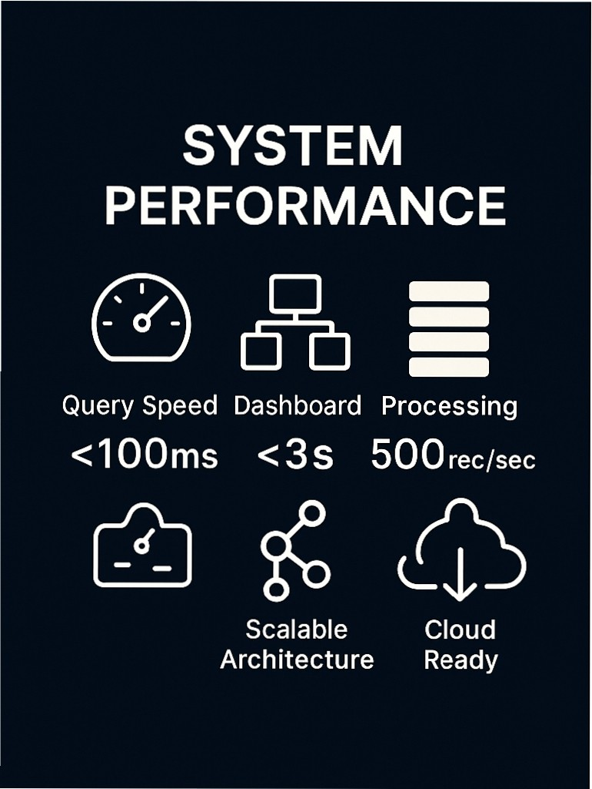

E-commerce Data Pipeline
Ingesting & Analy zing Orders, Customers, Products
Extract Transform Load Visualize Python ·PostgreSQL ·Streamlit

Slide 10




FUTURE ENHANCEM ENTS
Real-time data processing
with Kaf ka
Phase 1
Implement machine learning models
Deploy to cloud inf rastructure
Enable mobile access
Phase 2
Phase 3
· ··
Phase 4
( 0 J
Kafka
Phase 4
Phase 3

Slide 11







CHALLENGES
CHALLENGES
& SOLUTIONS
Addressing performance, scalability, security, and expertise gaps, through optimization, system expansion, data encryption, and targete d training.
Performance
Scalabilitty
Security
Optim-ization
Expansion Training
SOLUTIONS

Slide 12



PROJECT VALUE & IMPACT
EFFICIENCY
Improved operational eff iciency
ACCURACY
Enhanced data accuracy
COST REDUCTION
Lower operational costs
The project delivers signif icant business benef it s, including increased operational eff iciency, enhanced data accuracy, higher return on investment, and reduced
operational costs.

Slide 13
THANK YOU !!!!
PROJECT DONE BY
2310030202 K. AJAY JOHN PAUL
2310030149 RAM CHARAN
2310030417 HARI SRIRAMULU

